Slide 1


Linux Operating System
GSG Cloud COmputing Boot Camp

Slide 2
Installation Options.
Unix & Linux Introduction.
CLI & Basic shell commands.
Handling Files & Text Editors.
User Permissions.
Package Management.
Shell Scripting.
Automation & Cron Jobs
Content
1

Slide 3
Installation Options

Slide 4

Switch From Windows to Linux

Slide 5
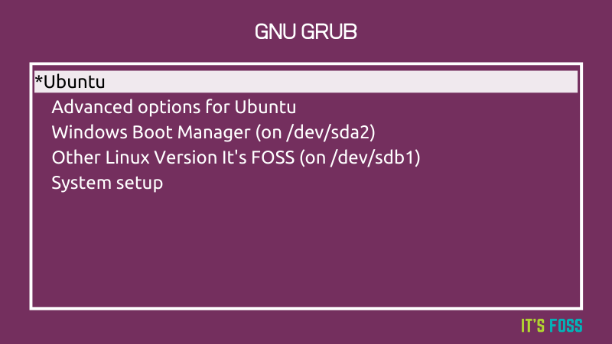


Switch From Windows to Linux
Dual Booting: Is when you run two operating systems on one computer at the same time

Slide 6
“ Linux shows no mercy to the first time installer ”

Slide 7
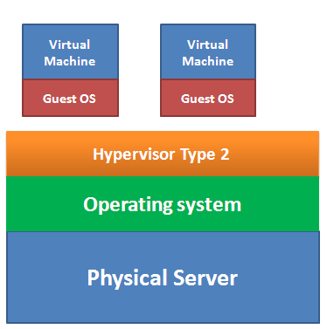


Virtual Machines
Hypervisor: A software called a virtual machine monitor that creates and runs virtual machines.
The hypervisor separates and isolates the hypervisor, operating system, and all the physical resources.
The hypervisor serves as an abstraction layer between the operating system and the underlying physical hardware.

Slide 8
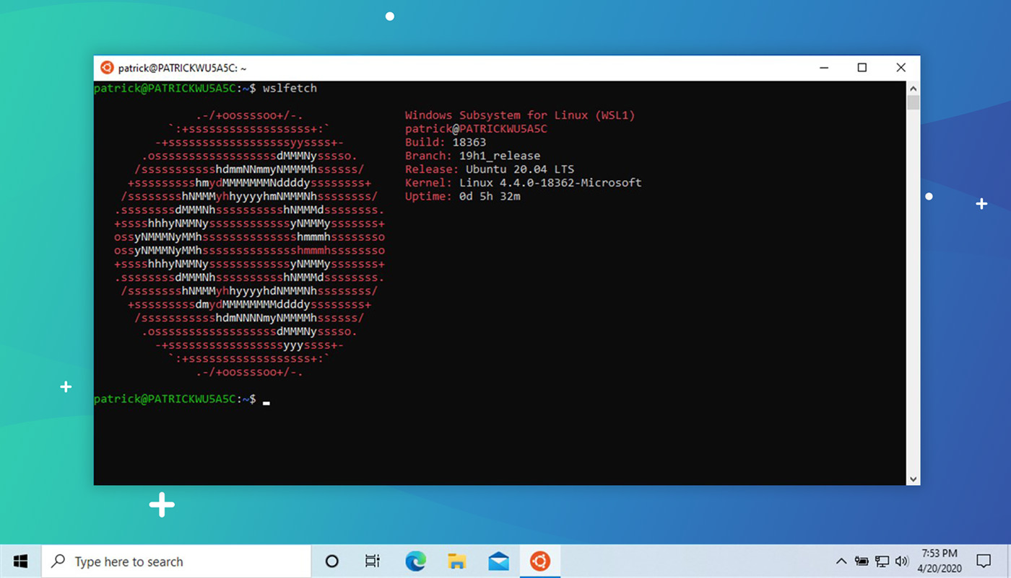
Windows Subsystem for Linux
Windows Subsystem for Linux: is a compatibility layer for running Linux binary executables natively on Windows
IT lets developers run a Linux environment directly on Windows, unmodified, without the overhead of a traditional virtual machine or dual boot setup.

Slide 9
Installation tutorials
Installing Ubuntu with Oracle Virtual box
Install Ubuntu on Windows Subsystem for Linux (WSL)
Dual boot windows with linux
Replace Windows with Ubuntu completely.

Slide 10
Unix & Linux Introduction.

Slide 11
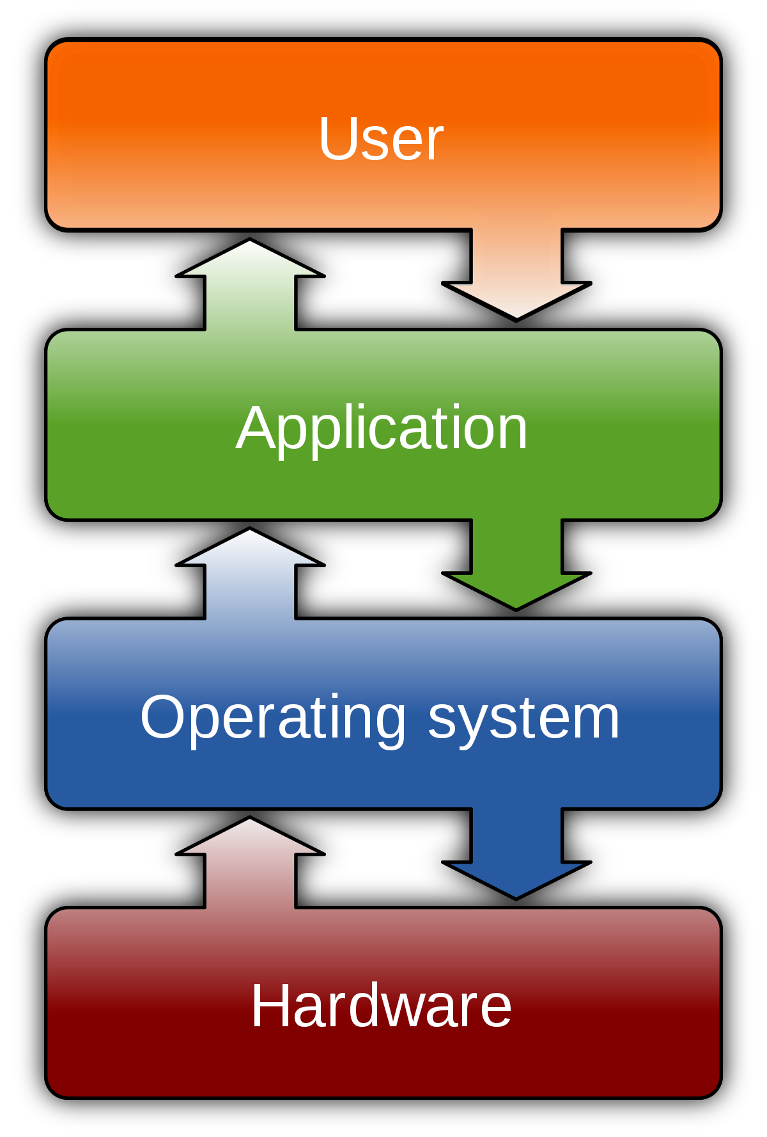



Operating system
is system software that manages computer hardware, software resources, and provides common services for computer programs.

Slide 12
Operating System Anatomy
Application
Shell
Kernel is the main layer between the OS and hardware
Kernel
Shell is a software interface that's often a command line interface that enables the user to interact with the computer.
Library Routines
Library Routines is a debugged block of code (procedure, function etc), often designed to handle commonly occurring problems or tasks

Slide 13
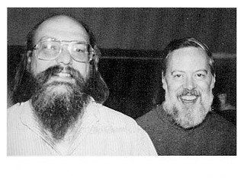
Unix VS Linux
Unix is a family of multitasking, multi-user computer operating systems that derive from the original AT&T Unix, whose development started in the 1970s

Slide 14
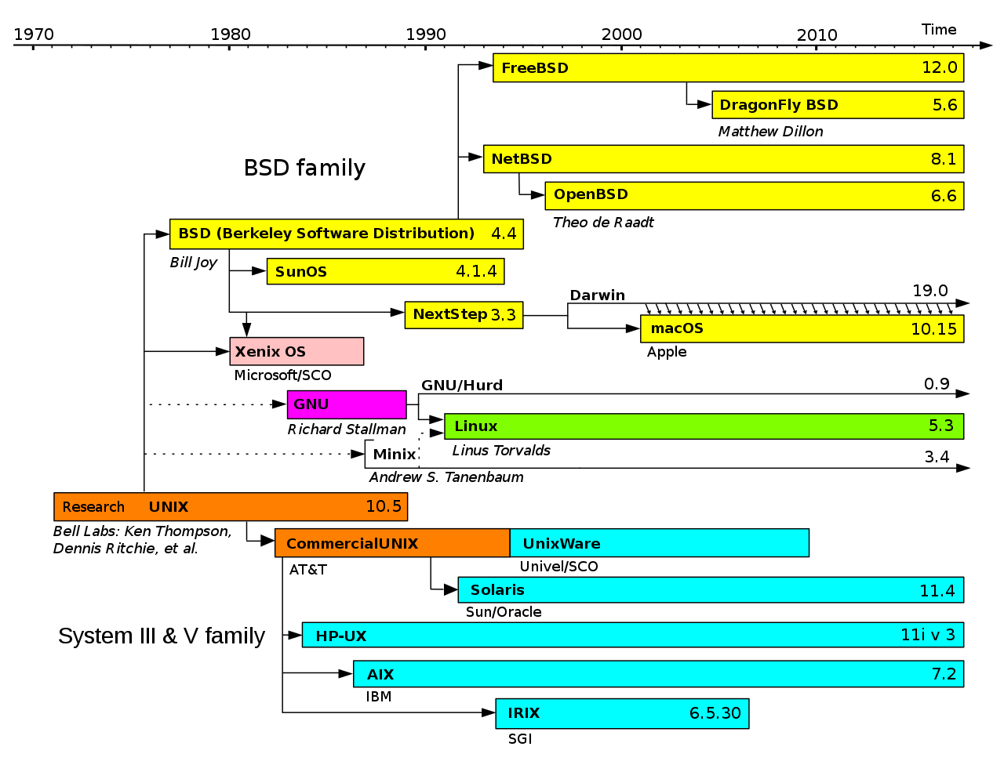
Unix VS Linux
Free software users have the freedom to run, copy, distribute, study, change and improve the software.

Slide 15



Unix VS Linux
GNU project (GNU is Not Unix). His goal was to make an operating system that was freely available to everyone.
Linux Kernel is a free and open-source, multitasking, Unix-like operating system kernel

Slide 16









Linux Distros
Distros Family Tree
Distro Watch

Slide 17

Why Linux?
2021 Statistics
96.3% of the world’s top 1 million servers run on Linux.
90% of all cloud infrastructure operates on Linux
Out of the top 25 websites in the world, only 2 aren’t using Linux.
Linux kernel runs on 81% - 86% of all Smartphones.

Slide 18
Why Linux?
Open Source.
Security.
Free to use (Low Cost).
Large Community Support.
Stability (Reliability)
Perfect For Programmers

Slide 19
Unix & Linux Introduction.

Slide 20
Shell
A Shell provides you with an interface to the Unix system. It gathers input from you and executes programs based on that input. When a program finishes executing, it displays that program's output.
REPL Read Evaluate Print Loop. It's basically an interactive way of programming where you're writing one line of code at a time, feeding data in and out of little programs.

Slide 21
Shell
There are many kind of shells:
Bourne shell (sh)
Korn shell (ksh)
Bourne Again shell (bash)
Z shell (zsh))
echo "$SHELL"
Your shell is running inside some sort of emulator.

Slide 22
Basic Command Structure
cd /Desktop
Desktop is an argument that we are passing to the command
ls -l
-l is a flag (bits of information that change how the command works. ls)

Slide 23
Understand a command options
Display one-line manual page descriptions
whatis ls
Display the whole command’s manual
man ls
Show some info about a command
ls --help
Show the location of a command
which ls

Slide 24
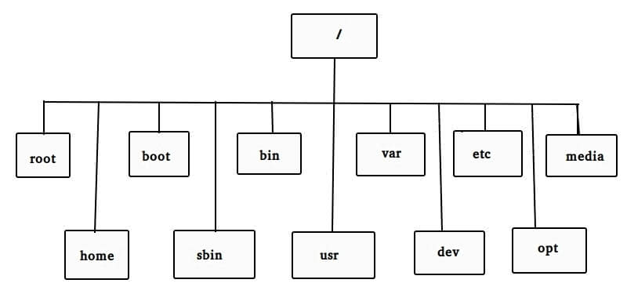
Files Management
/ (Root): Primary hierarchy root and root directory of the entire file system hierarchy.

Slide 25
Files Management
Home Directory: is a directory for a particular user of the system and consists of individual files
Current Directory: the directory in which the user is currently working in.
Print the current working directory
pwd

Slide 26
Files & Directories
Navigating the file system
cd
list directory contents
ls
Hidden Files: An invisible file is one, the first character of which is the dot or the period character (.) Used usually to store configuration information.
Single dot (.) This represents the current directory.
Double dot (..) This represents the parent directory.

Slide 27
Files & Directories
Install Tree
sudo apt install tree
Tree view
tree -L 2

Slide 28
Files & Directories
Creating Directories
mkdir dirname -p
Removing Directories
rmdir dirname
Moving Directory
mv olddir tmp/newdir
Renaming Directories
mv mydir yourdir

Slide 29
Files & Directories
Creating Files
touch test.txt
Removing Files
rm filename
Copying Files
cp source_file destination_file
Renaming Files
mv old_file new_file

Slide 30
Files & Directories
Displaying a file content
cat test.txt
Showing the first part of a file
head test.txt
Showing the last part of a file
tail test.txt -f
Installing lolcat
sudo apt install lolcat

Slide 31
Users & Groups
User: Anyone who accesses the resource such as user account, system process or application.
Group: A collection of users.
Permissions: Define how a user should be allowed to access the resources.
cat /etc/passwd

Slide 32
Users & Groups
Superuser accounts: These users/accounts may have virtually unlimited privileges, or ownership, over a system. Superuser account privileges may allow.
Full read/write/ execute privileges.
Creating or installing files or software.
Modifying files and settings.
Deleting users and data.

Slide 33
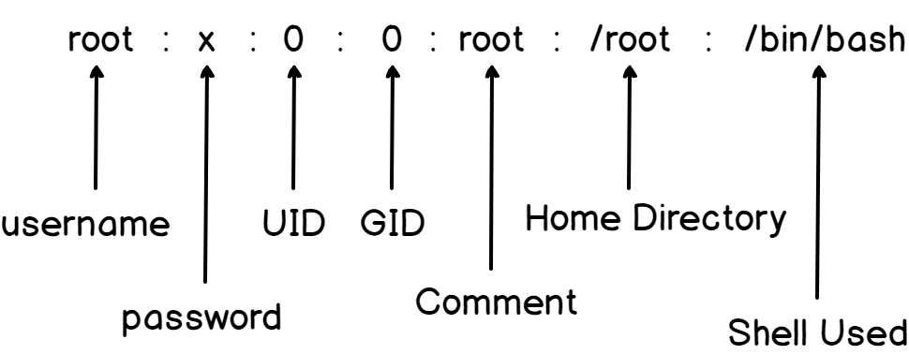
Users & Groups
cat /etc/passwd

Slide 34
Users & Groups
Adding new Group:
groupadd missing_semester
Deleting a group:
groupdel missing_semester
List groups that user belongs to:
groups gsg
Preview all groups:
getent group

Slide 35
Users & Groups
Adding new user:
adduser gsg -gid 0
Assigning password to user
passwd gsg
Removing user:
userdel gsg
Modifying user:
sudo usermod gsg -d /home
Adding User to an existing group:
usermod -a -G group_name user_name

Slide 36
Users & Groups
print real and effective user and group IDs
id gsg
print effective userid
whoami
execute a command as another user:
sudo (-i)
Login as a different user:
su gsg

Slide 37
Permissions
Permission Type | File | Directory
Read (r) | Can view the content of file | Can view the content of directory
Write (w) | Can write content in file | Can make new file or directory in directory
Execute (x) | Can execute the content of file | Can navigate through the directory

Slide 38
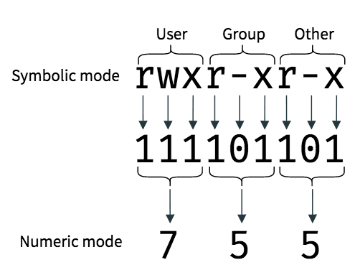
Permissions
List directory content
ls -lh
Each object has three permission levels
User (owner).
Group (owner).
Others.

Slide 39
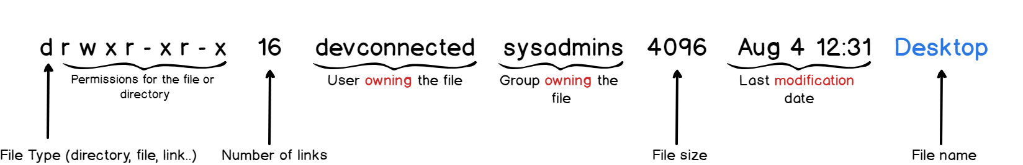
Permissions
Columns representation :

Slide 40
Permissions
A file/directory owner and group is assigned based on the user who created the file/directory
touch test.txt
sudo touch test.txt
sudo -u gsg touch test.txt

Slide 41
Permissions
We can change the permissions of a file/directory using the following command:
chmod #{who}#{what}#{which}
The “who” values we can use are:
u: User, meaning the owner of the file.
g: Group, meaning members of the group the file belongs to.
o: Others, meaning people not governed by the u and g permissions.
a: All, meaning all of the above.

Slide 42
Permissions
We can change the permissions of a file/directory using the following command:
chmod #{who}#{what}#{which}
The “what” values we can use are:
–: Minus sign. Removes the permission.
+: Plus sign. Grants the permission.
=: Equals sign. Set a permission and remove others.

Slide 43
Permissions
We can change the permissions of a file/directory using the following command:
chmod #{who}#{what}#{which}
The “which ” values we can use are:
r: The read permission.
w: The write permission.
x: The execute permission.

Slide 44
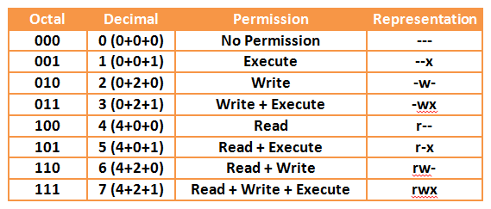
Permissions

Slide 45
Permissions
We can change the owner of a file/directory using the following command:
chown user filelist
We can change the group of a file/directory using the following command:
chgrp group filelist

Slide 46
Editing Files
Redirect stdout to file
Replace content
echo ‘sample text’ > test.txt
Append content
echo ‘sample text’ >> test.txt

Slide 47
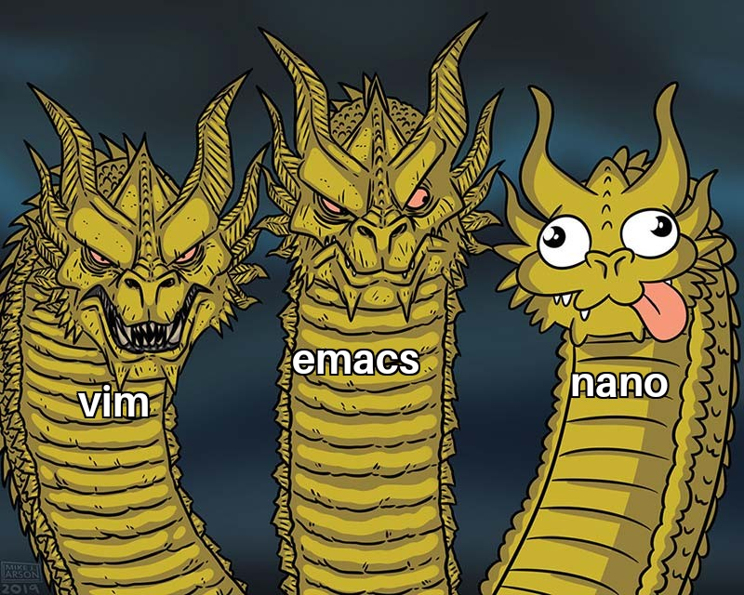
Editing Files
Nano
Vim
Emacs

Slide 48


Vim is a free and open-source, screen-based text editor program for Unix.
VIM Adventures
Basic Vim commands
How do I exit the Vim editor?

Slide 49
Process
A process: in simple terms, is an instance of a running program.
The operating system tracks processes through a five-digit ID number known as the pid or the process ID
There are 2 ways to run a process:
Foreground Processes
Background Processes

Slide 50
Process
Foreground Processes: By default, every process that you start runs in the foreground. It gets its input from the keyboard and sends its output to the screen.
While a program is running in the foreground and is time-consuming, no other commands can be run
rev

Slide 51
Process
Background Processes: A background process runs without being connected to your keyboard.
The simplest way to start a background process is to add an ampersand (&) at the end of the command.
sudo apt install oneko
oneko

Slide 52
Process
To list running process:
ps
Permission Type | File
-a | Shows information about all users
-u | Shows information about processes without terminals
-x | Shows additional information like -f option
-e | Displays extended information

Slide 53
Signals
A signal is a notification that you send to a program. It's up to the program to understand what to do with that.
CTRL + C – SIGINT Interrupt what it's doing and stop
CTRL + D – SIGQUIT Similar to the prev one (not all programs will respond to)
SIGTERM
kill Pid
SIGKILL
kill -9 Pid

Slide 54
Signals
To list all the Signals available on the system:
kill -l
To list running process:
ps

Slide 55



Services
A Service: essentially a process, running in the background and managed/provisioned by systemd.
systemd: which is the system and service manager
systemctl: a command line tool to interact with systemd

Slide 56
Services
To list devices, mount points, namespaces, and services.
systemctl
To list all services:
systemctl list-units --type=service

Slide 57
Services
Unit: Name of the Service
LOAD: means systemd knows about it.
ACTIVE: means systemd ran it successfully

Slide 58
Services
Show the Status of a certain service
systemctl status SERVICE_NAME
Start/Stop services
systemctl start/stop SERVICE_NAME

Slide 59
Services
Enable or Disable the services
systemctl enable/disable SERVICE_NAME
Start/Stop services
systemctl start/stop SERVICE_NAME

Slide 60
Pipes
“ Expect the output of every program to become the input to another”

Slide 61
Pipes
Transfer of standard output to some other destination
first_command | second_command
ls | lolcat

Slide 62
Pipes
/ Questionable day. \
| |
\ Ask somebody something. /
-------------------------
\ ^__^
\ (oo)\_______
(__)\ )\/\
||----w |
|| ||
sudo apt install cowsay
sudo apt install fortune

Slide 63
Grep
Globally search for a regular expression
grep pattern file(s)
history | grep cowsay

Slide 64




Package Management
Package manager: is a collection of software tools that automates the process of installing, upgrading, configuring, and removing computer programs for a computer's operating system in a consistent manner.

Slide 65
APT
apt: is a collection of software tools that automates the process of installing, upgrading, configuring, and removing computer programs for a computer's operating system in a consistent manner.
The APT package index is basically a database that holds records of available packages from the repositories enabled in your system.
cat /etc/apt/sources. list

Slide 66
A Lolcat => 1.5.1
MY PC Sources.list => a, b Apt update A => lolcat 1.5.1 B => cowsay 1.4.3 Apt install lolcat Lolcat => 1.5.0
B Cowsay =>1.4.3

Slide 67
Debugging issues:
sudo add-apt-repository main
sudo add-apt-repository universe
sudo add-apt-repository restricted
sudo add-apt-repository multiverse

Slide 68
APT
Updating package index
apt update
Upgrading packages
apt upgrade
Installing packages
apt install
Removing Packages
apt remove

Slide 69
APT
Remove Unused Packages
apt autoremove
Listing Packages
apt list
Package Information
apt show
Searching Packages
apt search

Slide 70

APT
Use the Following Steps to install and run a React project.

Slide 71

Snapcraft
Snaps are app packages for desktop, cloud and IoT that are easy to install, secure, cross‐platform and dependency‐free.
apt install snapd
sudo snap install snap-store

Slide 72
Shell Scripting
The basic concept of a shell script is a list of commands, which are listed in the order of execution.
The shell is, after all, a real programming language, complete with variables, control structures, and so forth. No matter how complicated a script gets, it is still just a list of commands executed sequentially.

Slide 73
Shell Scripting
All shell scripts should have the .sh extension
touch first.sh
To run the script the file needs to have the executable file permission.
chmod a+x first.sh

Slide 74
Shell Scripting
Let’s start with this example:
Copy the Following Into your file:
#!/bin/sh
cowsay “Your First Shell Script”
Run the file using the Following command
sh first.sh

Slide 75
Shell Scripting
The first line in the file indicate which shell you are using:
which bash
A good shell file should have comments. Add some using #
# This is my first script

Slide 76
Shell Variables
There are multiple type of variables :
Local Variables − A local variable is a variable that is present within the current instance of the shell.
Environment Variables − An environment variable is available to any child process of the shell.
Display environment variables
env

Slide 77
Shell Variables
A variable is nothing more than a pointer to the actual data. The shell enables you to create, assign, and delete variables.
Define a variable
VAR1=Test
The name of a variable can contain only letters (a to z or A to Z), numbers ( 0 to 9) or the underscore character ( _).
Access a variable
echo $Test

Slide 78
Shell Variables
Read-only Variables
readonly Test
Unsetting Variables
unset variable_name

Slide 79
Shell Variables
A variable is nothing more than a pointer to the actual data. The shell enables you to create, assign, and delete variables.
Define a variable
VAR1=Test
The name of a variable can contain only letters (a to z or A to Z), numbers ( 0 to 9) or the underscore character ( _).
Access a variable
echo $Test

Slide 80
Read Input
Read Input from users
read variable_name
The last command will wait for user to enter input until the newline and will store it in the variable_name.
Output the value stored
echo $variable_name

Slide 81
Arithmetic Operations
#!/bin/bash
echo "Enter first number"
read x
echo "Enter second number"
read y
(( sum=x+y ))
echo "The result of addition=$sum"

Slide 82
IF statement
#!/bin/bash
n=10
if [ $n -lt 10 ];
then
echo "It is a one digit number"
else
echo "It is a two digit number"
fi

Slide 83
While Loop
#!/bin/bash
valid=true
count=1
while [ $valid ]
do
echo $count
if [ $count -eq 5 ];
then
break
fi
((count++))
done

Slide 84
For Loop
#!/bin/bash
for (( counter=10; counter>0; counter-- ))
do
echo -n "$counter "
done
printf "\n"

Slide 85
Passing Argument
You can pass any argument you want to a shell script
Variable | Description
$0 | The filename of the current script.
$n | Here n is a positive decimal number corresponding to the position of an argument
$# | The number of arguments supplied to a script.
$@ | All the arguments are individually double quoted.

Slide 86
Arguments from Command Line
#!/bin/bash
echo "Total arguments : $#"
echo "1st Argument = $1"
echo "2nd argument = $2"

Slide 87
Functions
#!/bin/bash
function F1()
{
echo 'I like bash programming'
}
F1

Slide 88
Automation & Cron Jobs
The crontab is a list of commands that you want to run on a regular schedule,
Cron folders Any script you put in any of the following will be run on a schedule:
/etc/cron.daily
/etc/cron.hourly
/etc/cron.monthly
/etc/cron.weekly

